Slide 1
Semi-Supervised Hashing for Scalable Image Retrieval
J.Wang , O.Kumar , S.-F. Chang
2010 IEEE Conference on
Computer Vision and Pattern Recognition
Notes:
备注

Slide 2
Introduction
Semi-Supervised Hashing
Experiment
Conclusions

Slide 3
Introduction
Text-Based Image Retrieval

Slide 4
Introduction
CBIR
directly take an image as query and try toreturn its nearest neighbors from a given database of images using a pre-specified similarity metric .
"Content-based" means that the search analyzes the contents of the image rather than the metadata such as keywords, tags, or descriptions associated with the image.
The term "content" in this context might refer to colors, shapes, textures, or any other information that can be derived from the image itself.

Slide 5
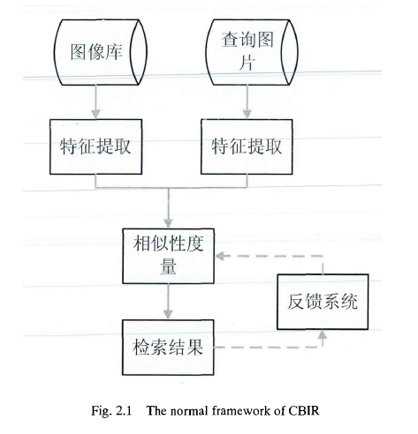

Slide 6
Weakness:
1.semantic gap
2.the curse of dimensionality
3.storage of the original data

Slide 7
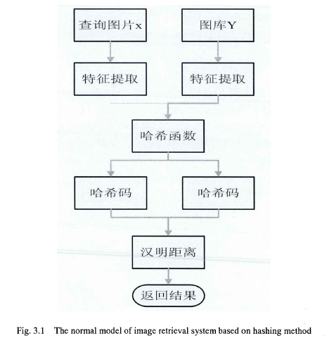
Hashing Methods

Slide 8
Hashing Methods
Unsupervised :
use just the unlabeled data to generate binary codes for the given points.
LSH
SH

Slide 9
LSH
Locality-sensitive hashing (LSH) reduces the dimensionality of high-dimensional data.
LSH hashes input items so that similar items map to the same “buckets” with high probability (the number of buckets being much smaller than the universe of possible input items).
LSH differs from conventional and cryptographic hash functions because it aims to maximize the probability of a “collision” for similar items.
Locality-sensitive hashing has much in common with data clustering and nearest neighbor search.

Slide 10
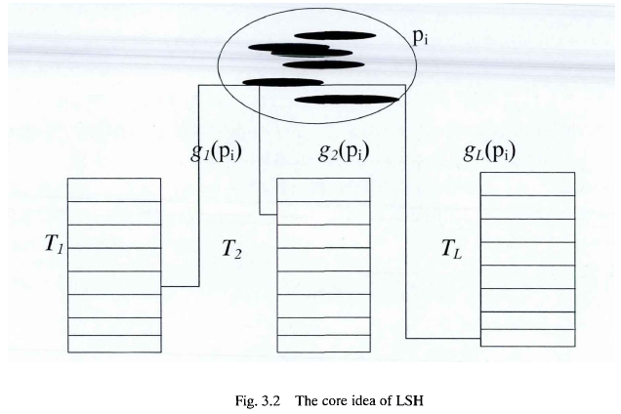

Slide 11
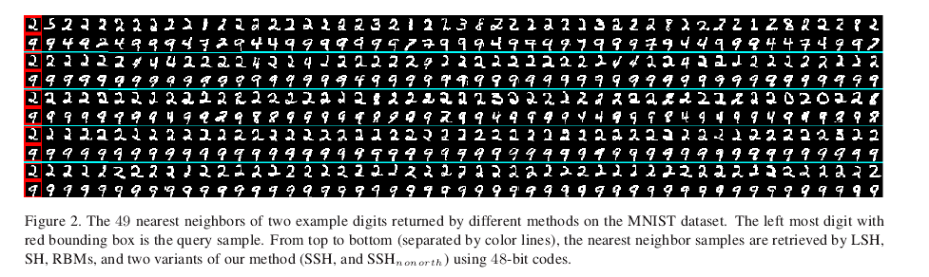
Weakness:
May not preserve semantic similarity

Slide 12
Supervised :
BoostSSC
RBMs

Slide 13
Problems:
1.much slower in comparison to the unsupervised methods.
2.from limited or noisy traning.(overfitting)

Slide 14
Semi-Supervised Hashing
leverage semantic similarity using labeled data while remaining robust to overfitting.
much faster than existing supervised hashing methods and can be easily scaled to large datasets.

Slide 15



Slide 16



Slide 17
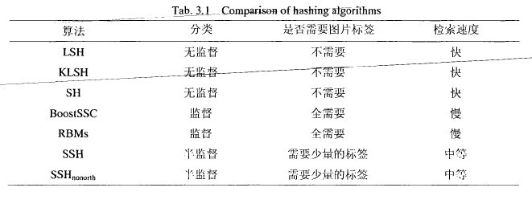

Slide 18

Experiments
LSH,SH,RBMs,SSH,${SSH}_{nonorth}$
MNIST Digits

Slide 19
MNIST Digits
The MNIST dataset consists of a total of 70000 hand-written digit samples, each of size 28*28 pixels. Each sample is associated with a label from 0 to 9.
The entire dataset is partitioned into two parts: a training set with 69000 samples and a test set with 1000 samples.

Slide 20
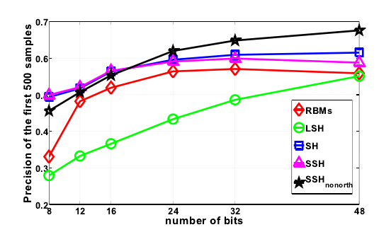
Experimental results on MNIST digit dataset
The precision of the first 500 retrieval neighbors

Slide 21
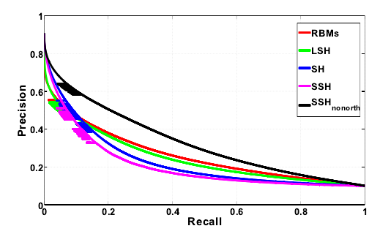
The precision recall curve using 48-bit codes

Slide 22
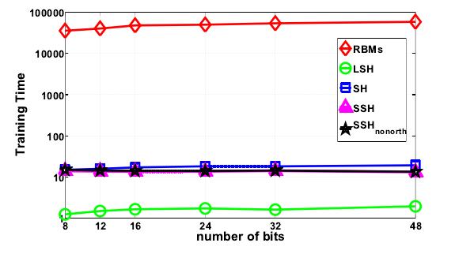
Traning cost(in seconds) using different number of bits

Slide 24
Conclusions
we have proposed a semi-supervised paradigm to learn efficient hash codes which can handle se-mantic similarity/dissimilarity among the data points.
The proposed method combines empirical loss over the labeled data with other desirable properties e.g., balancing over both labeled and unlabeled data.
The experiments on two large datasets show superior performance of the proposed method over existing state-of-the-art techniques.

